Slide 1

Product Management Module 9 –Office Hrs with Raunak Goyal Dec 10, 2023

Slide 2
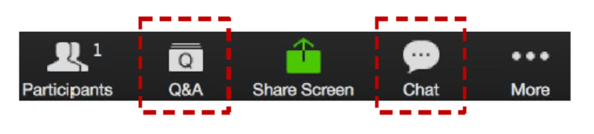
ZOOM: CHAT and Q&A BOX
Please enter your questions in the Q&A box. We’ll answer these in the Q&A and stop from time to time to bring these to the broader attention of the class
Please enter your response in the ‘Chat box.’ Before you send it, please make sure that your response goes to ‘Everyone’
Please type your questions in the Q&A box
Also, ongoing discussion in the Chat
Notes:
Please enter your questions in the Q&A box. We’ll answer these in the Q&A and stop from time to time to bring these to the broader attention of the class.
Please enter your response in the ‘Chat box.’ Before you send it, please make sure that your response goes to ‘Everyone’
We will continue to try to make the sessions interactive. Raise your hand if you’d like to talk and we will unmute you. For questions that we can not answer interactively we will take offline and post them in the discussion groups.
Now for today’s agenda

Slide 3




Agenda
Module Review
Assignment Discussions
Additional Resources
Programme Schedule
Next Week
Q&A
Notes:
In today’s session we will cover the following topics:
Module Review
Assignment Discussions
Additional Resources
Programme Schedule
Next Week
Q&A – We will reserve the last 15-30 minutes of the session for additional questions if they were not answered online or during the review and assignment discussion.

Slide 4
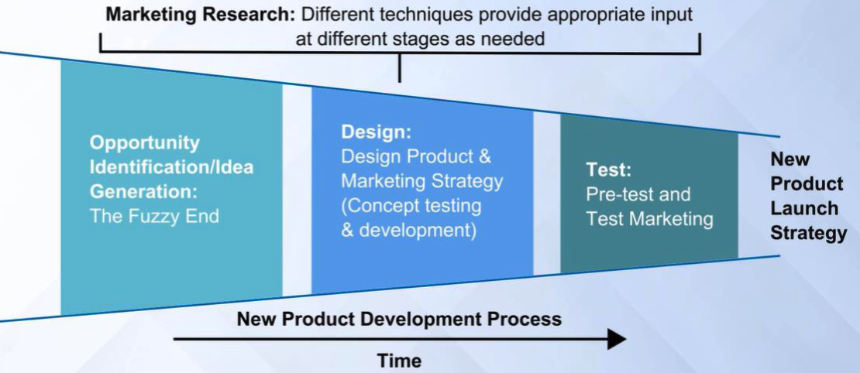
Module Review – New Product Introduction
Notes:
Note that we are still in the design phase. This week we focus a bit more on Market Research to help guide your product development.

Slide 5
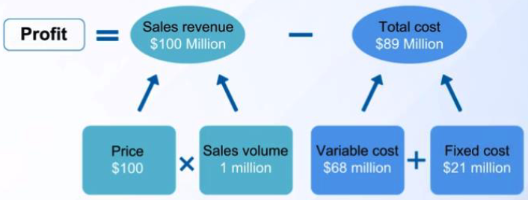
MODULE REVIEW – PRICING BACKGROUND
Notes:
The fundamentals of pricing is that you want to first show a profit, second to maximize profit.
The basic inputs are the Sales Revenues minus the Total Cost
Which breaks down further to the price of the product times the sales or unit volume
MINUS
The Variable Cost + The Fixed Cost.

Slide 6
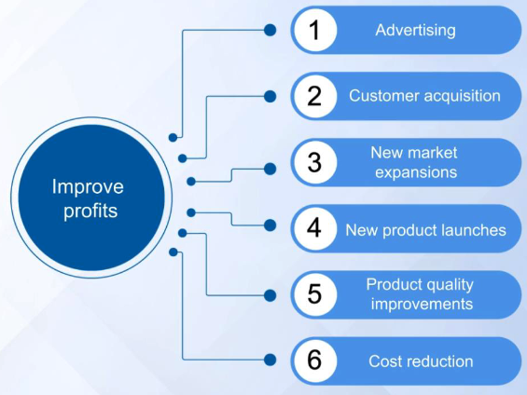
MODULE REVIEW – BACKGROUND
Notes:
Assuming we have a profitable product, what can we do to improve Profits:
Advertising to help increase sales volume
Customer Acquisition
New market expansions to increase the reach of the product, which would increase the sales volume
New product launches which may change some of the dynamics between the broader profit equation or maybe to address competitive pressures to maintain sales volume
Product Quality improvement – For similar reasons, to help maintain sales due to the better performance of the product
Cost reductions – To decrease the product cost, which can provide more pricing latitude . . . Though may also impact the perception of quality.

Slide 7
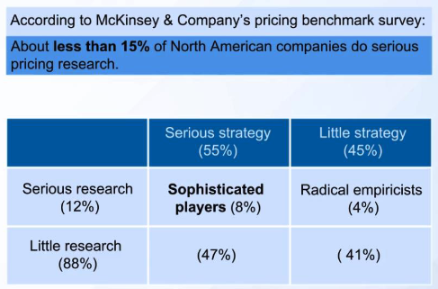
MODULE REVIEW – WHO DOES PRICING ANALYSIS
Notes:
So, what should you focus on? It is hard to tell though here is some research from the lectures . . .
Less than 15% of North American companies do serious pricing research . . .

Slide 8
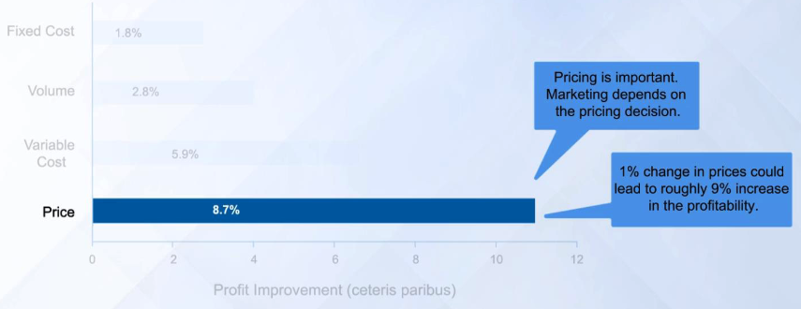
MODULE REVIEW – WHY PRICING IS IMPORTANT
Notes:
Of those that do they find that a 1% change in price could lead to roughly 9% increase in the profitability.
So, let’s focus a bit on pricing . . .

Slide 9
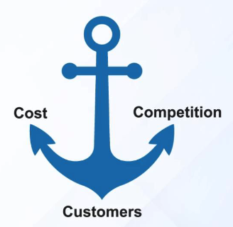
MODULE REVIEW – TYPES OF PRICING
Notes:
There are basically three ways that firms perform pricing:
Cost based where they assess their costs and mark that amount up for a reasonable profit
Competition based where they look at what others charge in the market and base pricing off that anchor
Customer based where they look to customers to define the value of the product/solution.
The first 2 are easier to research and set
Customer based is more valuable to the firm. Amazon is a company that is obsessed with solving customer problems and ignoring their competition. It can often be a great way to the approach the market due to the long term value you can create, though it is more work.
The pricing exercises we are working through are Customer based and really about finding the value of the product/solution for the customer.

Slide 10
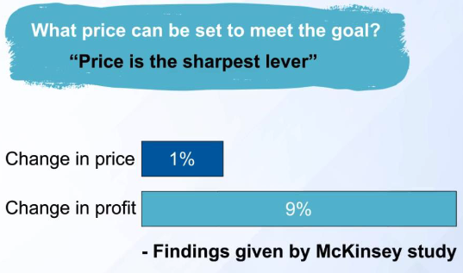
MODULE REVIEW – THE PRIMARY LEVER
Notes:
Recall the earlier McKinsey study, a 1% change in price can create a 9% change in profit. Getting the price right can have a big impact on your company’s bottom line.
So, how do we determine price?
I won’t go through the calculations of profitability though I would like us to focus on the relationship between Price and Demand.

Slide 11
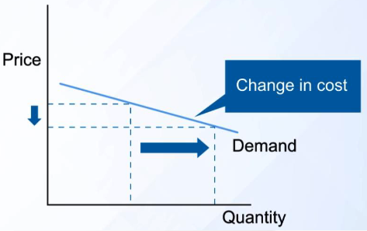
MODULE REVIEW – SIMPLE PRICING CURVE
Notes:
The simple conceptual picture is that as you lower price you increase demand.
Of course, in the real world, we do not just modify the price, we modify:
The features of the product
The distribution of the product
The component of the product
And many other factors.
The lectures walk you through a number of pricing methods, though let’s focus on the one that you are asked to use for the assignment, the Van Westendrop Price Sensitiivity Meter to help us narrow down the pricing sweetspot.

Slide 12
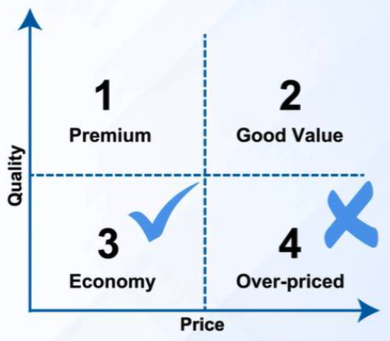
MODULE REVIEW – FIND THE SWEET SPOT
Notes:
Most economists will tell you that price is a very strong signal. Though, as you may recall, that signal can cut two ways:
Price the product too low the customers think it may be poor quality
Price the product too high the customers think it is too expensive to purchase.
What to do? As professor Gangwar said in the lectures, try to find the “sweet spot” of the pricing.

Slide 13


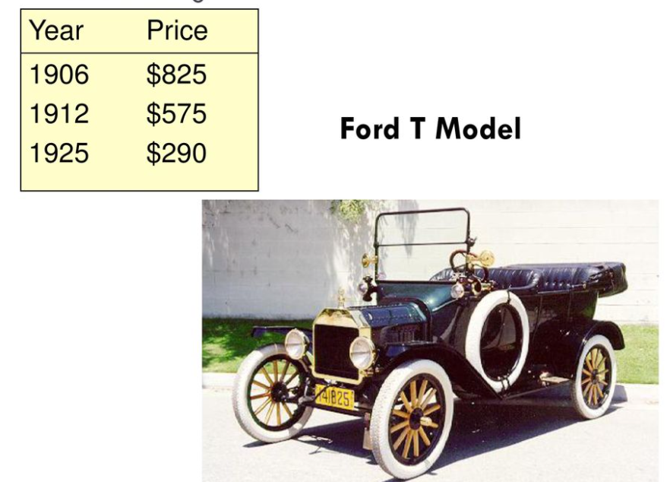


PRICING STRATEGY QUIZ
Complimentary pricing
Price Bundling
Premium pricing
Value pricing
Price Skimming

Slide 14
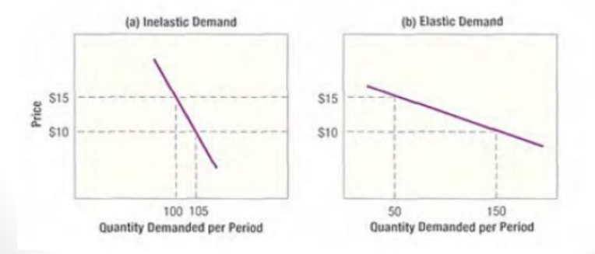
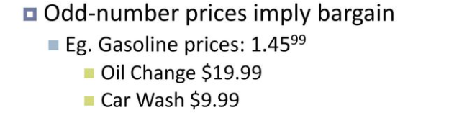
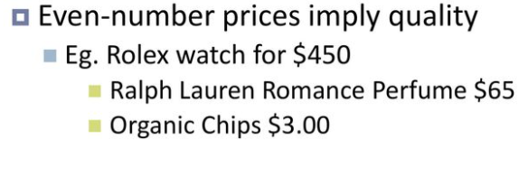
PRICING STRATEGY QUIZ
What’s the difference between elastic/inelastic demand?
If demand changes considerably, demand is elastic
The higher the elasticity, the greater the volume growth resulting from a 1 percent price reduction
The more inelastic the demand, the higher the company can set the price
Psychology Pricing

Slide 15
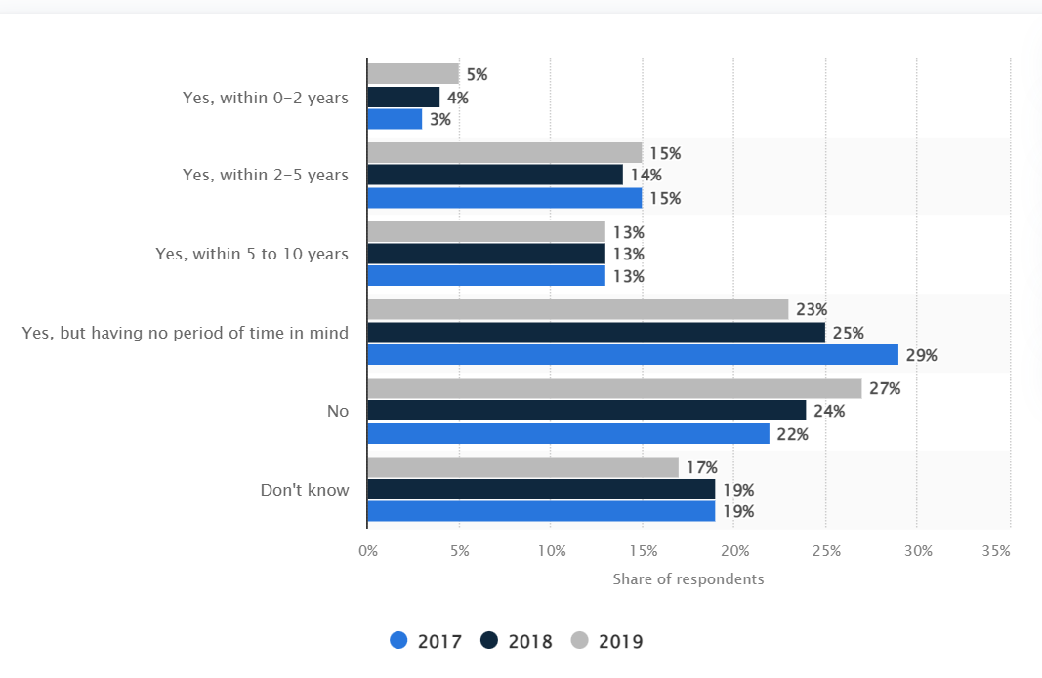
PURCHASE INTENT OF ELECTRIC CARS
Notes:
Purchase Intent of electric cars in the Netherlands from 2017 to 2019
As of 2019, five percent of the respondents indicated that they have the intention to purchase an electric car, whereas the majority of the respondents mentioned to have either no period of time in mind or no intention to purchase an electric car.

Slide 16
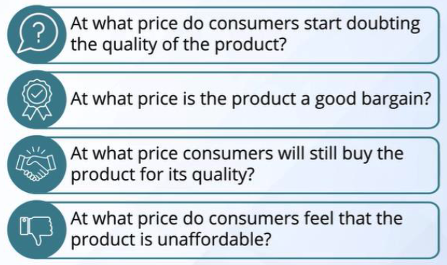
MODULE REVIEW – VAN WESTENDORP 4 QUESTIONS
Notes:
The 4 questions to answer:
At what price do consumers start doubting the quality of the product
At what price is the product a good bargain?
At what price will consumers still buy the product for its quality?
At what price do consumers feel that the product is unaffordable?
Questions 1 and 3 are the price sensitivity questions
Questions 2 and 4 are the quality sensitivity questions

Slide 17
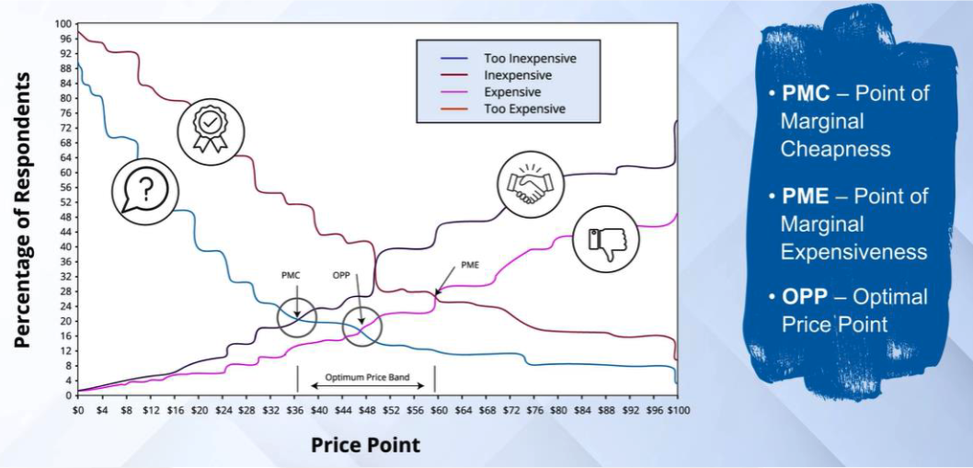
MODULE REVIEW – VAN WESTENDORP DEFINITIONS
Notes:
Surveying the customers with these 4 questions you are trying to generate a graph that looks something like this, where each line represents the responses to each of the 4 questions. This will product a few key intersection points:
PMC – Point of Marginal Cheapness
PME – Point of Marginal Expensiveness
OPP – Optimal Price Point
The broad objective is to find the Optimal price point, or the sweet spot.
Though by performing this analysis you should at least narrow down the range of where the sweet spot lies.
With that as the high level background let’s take a look at the assignment.

Slide 18
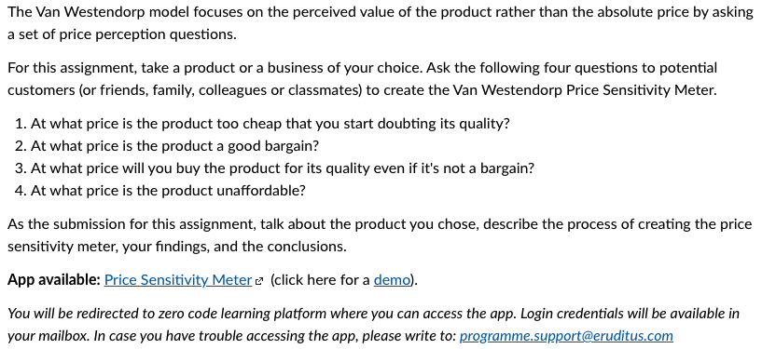
ASSIGNMENT 9.2 PROBLEM
Notes:
Assignment Instructions:
The Van Westendorp model focuses on the perceived value of the product rather than the absolute price by asking a set of price perception questions.
CLICK
For this assignment, take a product or a business of your choice. Ask the following four questions to potential customers (or friends, family, colleagues or classmates) to create the Van Westendorp Price Sensitivity Meter.
At what price is the product too cheap that you start doubting its quality?
At what price is the product a good bargain?
At what price will you buy the product for its quality even if it's not a bargain?
At what price is the product unaffordable?
CLICK
As the submission for this assignment, talk about the product you chose, describe the process of creating the price sensitivity meter, your findings, and the conclusions.
CLICK
There is an app available that will run the analysis.
App available: Price Sensitivity Meter (Links to an external site.) (click here for a demo).
You will be redirected to zero code learning platform where you can access the app. Login credentials will be available in your mailbox. In case you have trouble accessing the app, please write to: programme.support@eruditus.com

Slide 19
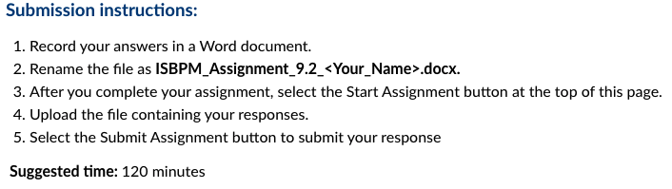
ASSIGNMENT 9.2 PROBLEM
Notes:
Submission instructions:
CLICK Similar to other assignments
Record your answers in a Word document.
Rename the file as ISBPM_Assignment_9.2_<Your_Name>.docx.
After you complete your assignment, select the Start Assignment button at the top of this page.
Upload the file containing your responses.
Select the Submit Assignment button to submit your response
CLICK
Suggested time: 120 minutes

Slide 20
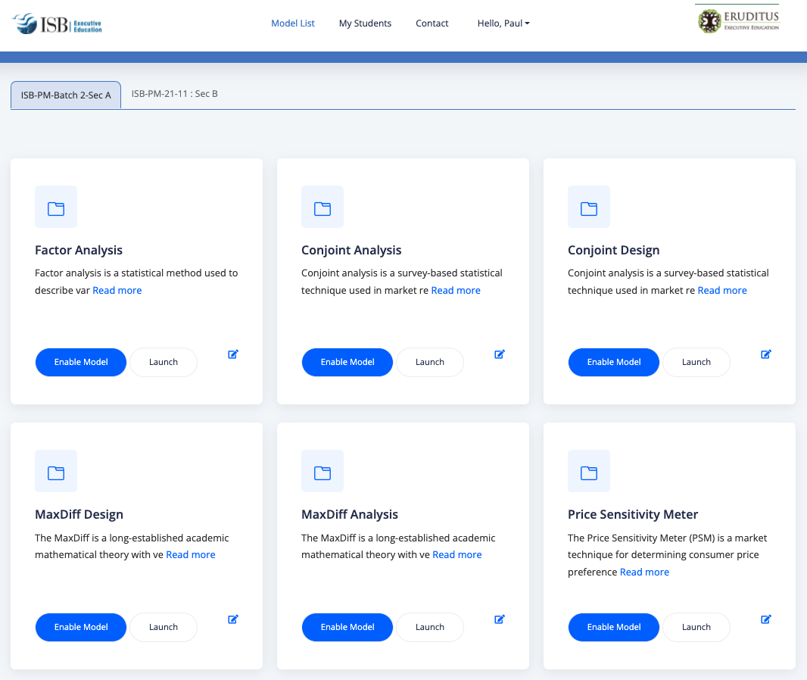
QUESTIONS FROM DISCUSSION BOARDS AND IN-BOX
For the required assignment should we use zero code learning app or conjointly to derive insights?
Notes:
For the required assignment are we supposed to use zero code learning app or conjointly to derive insights?
I would suggest using the Zero Code application. After you collect your data you can do the analysis in the application though you are free to do it any way you choose.
The professor walks through the Price Sensitivity Meter demonstration in video 11. He says you can do the analysis in Excel, though the application in Zero Code is all set up for you.
SWITCH SCREENS

Slide 21
ASSIGNMENT 9.2 CRITERIA
As the submission for this assignment, talk about the product you chose, describe the process of creating the price sensitivity meter, your findings, and the conclusions.
At what price is the product too cheap that you start doubting its quality?
At what price is the product a good bargain?
At what price will you buy the product for its quality even if it's not a bargain?
At what price is the product unaffordable?
Notes:
Recall you are asked to do the following
As the submission for this assignment, talk about the product you chose, describe the process of creating the price sensitivity meter, your findings, and the conclusions.
CLICK
At what price is the product too cheap that you start doubting its quality? How do you ask this question? Did you use the tool?
At what price is the product a good bargain?
At what price will you buy the product for its quality even if it's not a bargain?
At what price is the product unaffordable?
This leads to a question from the Discussion Boards.

Slide 22
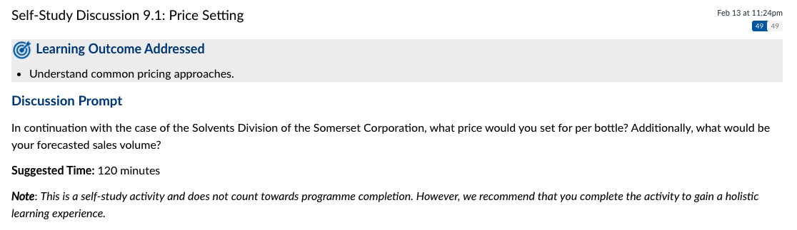
ASSIGNMENT 9.2 PROBLEM
Notes:
We thought we should also add in the Self Study Discussion Question. There has been lots of great discussion about the price setting with people providing great input. Let’s take a few minutes to continue the discussion live. Here is the prompt:
CLICK
In continuation with the case of the Solvents Division of the Somerset Corporation, what price would you set for per bottle? Additionally, what would be your forecasted sales volume?

Slide 23


ADDITIONAL RESOURCES
Notes:
The first is an article from Forbes Magazine:
How To Price Your Product: A Guide To The Van Westendorp Pricing Model
https://www.forbes.com/sites/rebeccasadwick/2020/06/22/how-to-price-products/?sh=14e5a13d55c7
Also, you all may remember the Conjointly product, they have a nice article on the Van Westendorp pricing Model.
https://conjointly.com/products/van-westendorp/

Slide 24

ADDITIONAL RESOURCES
Notes:
And a nice summary article from the Profitwell website:
PRICING STRATEGY GUIDE: TOP PRICING STRATEGIES AND HOW THEY UNLOCK GROWTH
https://www.priceintelligently.com/blog/bid/163986/a-complete-guide-to-pricing-strategy

Slide 25
ADDITIONAL RESOURCES
https://www.wallstreetmojo.com/top-best-pricing-books/
https://blog.pricebeam.com/8-great-books-about-pricing
https://insightoutdigital.com/10-best-books-on-pricing-strategy/
https://bookauthority.org/books/best-product-pricing-books
https://www.bdc.ca/en/articles-tools/marketing-sales-export/marketing/pricing-5-common-strategies
Reference links on van-westendorps-price-sensitivity-meter https://www.forbes.com/sites/rebeccasadwick/2020/06/22/how-to-price-products/?sh=4ffe0e2655c7
https://towardsdatascience.com/pricing-research-van-westendorps-price-sensitivity-meter-in-python-ec07fabbeacd
https://www.questionpro.com/blog/van-westendorp-price-sensitivity-meter/
https://conjointly.com/products/van-westendorp/
Notes:
Here are a number of additional links on the VanWestendorp Price Sensitivity Meter.
https://www.wallstreetmojo.com/top-best-pricing-books/ https://blog.pricebeam.com/8-great-books-about-pricing https://insightoutdigital.com/10-best-books-on-pricing-strategy/ https://bookauthority.org/books/best-product-pricing-books https://www.bdc.ca/en/articles-tools/marketing-sales-export/marketing/pricing-5-common-strategies
Reference links on van-westendorps-price-sensitivity-meter https://www.forbes.com/sites/rebeccasadwick/2020/06/22/how-to-price-products/?sh=4ffe0e2655c7 https://towardsdatascience.com/pricing-research-van-westendorps-price-sensitivity-meter-in-python-ec07fabbeacd https://www.questionpro.com/blog/van-westendorp-price-sensitivity-meter/ https://conjointly.com/products/van-westendorp/

Slide 26
NEXT WEEK
Course/Program learning outcomes addressed this week:
Evaluate product road-mapping and prototyping decisions using various product management techniques and practices.
Outline a plan to create a competitive, scalable product using key product development strategies and frameworks.
By the end of this week, you will be able to:
Learn to innovate beyond the product.
Balance brand positioning, pricing and distribution.
Understand how to build differentiated brands in sectors like FMCG markets, fintech services and consumer durables.
Understand the role of marketing and brand strategy in enhancing brand equity.
Notes:
Course/Program learning outcomes addressed this week:
Evaluate product road-mapping and prototyping decisions using various product management techniques and practices.
Outline a plan to create a competitive, scalable product using key product development strategies and frameworks.
By the end of this week, you will be able to:
Learn to innovate beyond the product.
Balance brand positioning, pricing and distribution.
Understand how to build differentiated brands in sectors like FMCG markets, fintech services and consumer durables.
Understand the role of marketing and brand strategy in enhancing brand equity.

Slide 27

Over to you!

Slide 28


Approach to Establish Market-driven Pricing
3. Identify “Top Down” expectations for Revenue (Market Share, Profit) Targets
5. Inputs
Total Addressable Market (TAM)
Understand need product satisfies, existing Customer base – countries, price points, strengths and weaknesses.
Competitors’ Products and Prices/Substitutes
CC - Value Proposition – Aligned with CC?
Product Positioning – aligned with CC?
Environmental and Cultural issues
Cost to produce, cost reduction strategy and target costs
Prices - - floor and ceiling
Assumptions for missing data
Demand curve
1. Team/individual driving pricing?
2. Understand objectives
Grab market share
Maximize revenues
Maximize profit
6. Synthesize Inputs
7. Establish volume and revenue
targets.
8. Align Views to secure Outputs
9. Shake hands and Monitor
10. Outputs
Sales commitment to volumes and revenue targets
Business model and regional pricing strategy for each product array
FCE roles and responsibilities
Ways to bundle/unbundle and discount for increased sales
Partnerships/Strategic Alliances/ Channels/ Direct Marketing to increase volume/margins
Maintain scoreboard
Placement
4. “Bottom up” Marketing and Sales assessment.
P
P
C
C
4P’s
C
Promotion
Product - TPO
P
P
3C’s

